Slide 1
Github with git
version control
-Yixuan ZHANG / GLTc Canton, China

Slide 2

What is GitHub?
GitHub is a collaboration platform built on top of a distributed version control system called Git.
Notes:
Les curieux que vous êtes avez sûrement entendu parler de Github, un réseau social un peu différent de Facebook où ça parle de code. Github est basé sur git, un utilitaire développé par le créateur de Linux, et qui joue un rôle central dans tout projet de développement : celui de système de gestion des versions.
Git est un logiciel de contrôle de version, ce qui signifie qu’il gère les modifications d’un projet sans écraser n’importe quelle partie du projet. Et il ne risque pas de disparaîtr.
Pourquoi utiliser quelque chose comme Git ? Supposons que vous mettiez à jour avec un collègue des pages sur le même site web. Vous faites des modifications, vous les sauvegardez et les versez sur le site. À ce stade, tout va bien. Le problème survient quand votre collègue travaille sur la même page que vous en même temps. L’un de vous va voir son travail écrasé.
Une application de contrôle de version comme Git empêche ça d’arriver.

Slide 3
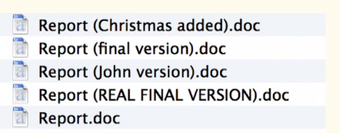

MANUAL VERSION CONTROL
When, What, Why, Who?
Notes:
On a envie de ameliorer:
Quand le fichier est modifie
Quest- ce que il est modifie
Pourquoi il est modifie
Qui l’a modifie.
Dropbox, googledrive ( ne fonctionne pas bien avec code)
Besoin de un outil specifique. (SVN,

Slide 4
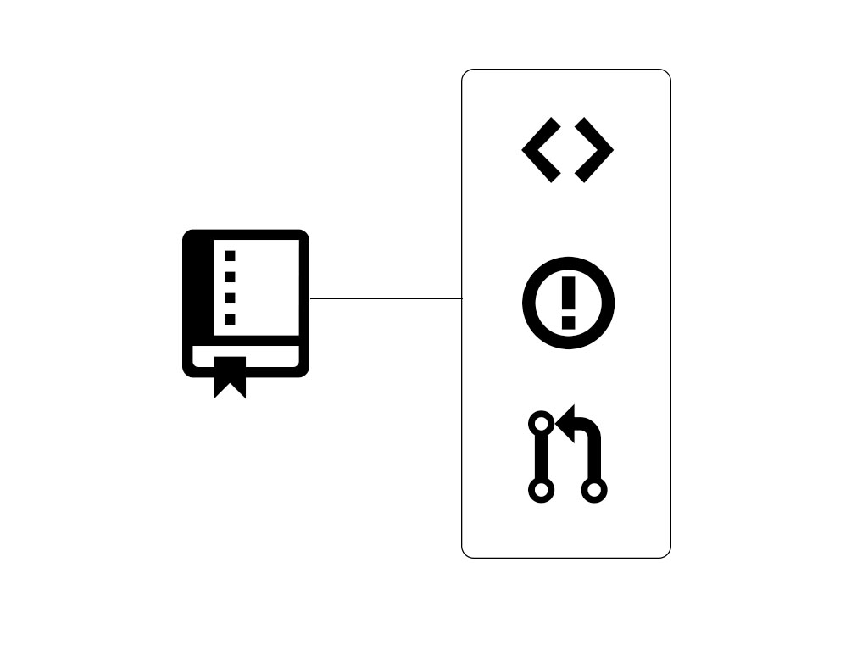

GitHub Repositories
A repository contains all of the project files (including documentation), and stores each file's revision history. It is easiest to imagine as a project's folder. However, a GitHub repository offers simple yet powerful tools for collaborating with others.
Notes:
Comment partager?

Slide 5
Planning
Git ( work with branch ) - branch, workflow
GitHub ( share your code) - pull request, documentation, cool things
Our feedback
Usefull links: install hsbc(GSR), tutorial

Slide 6
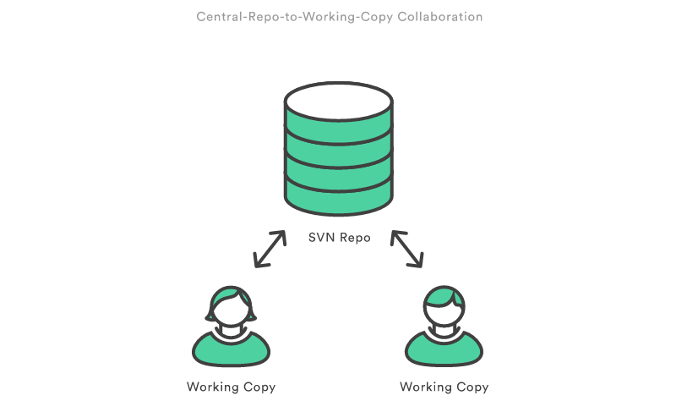
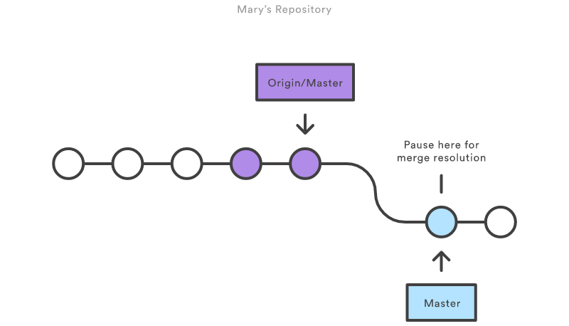
How we work together (Branch)

Slide 7
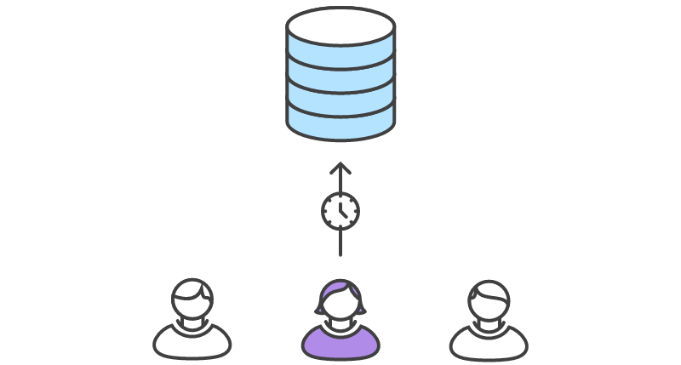

How we work together (Branch)

Slide 8
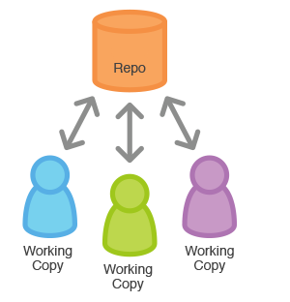
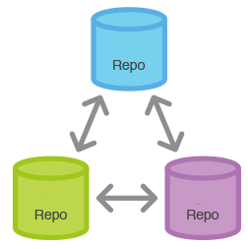
How we work together (Branch)
Central-Repo-to-Working-copy(SVN)
Repo-to-Repo (Git)
Notes:
REPOSITORY

Slide 9
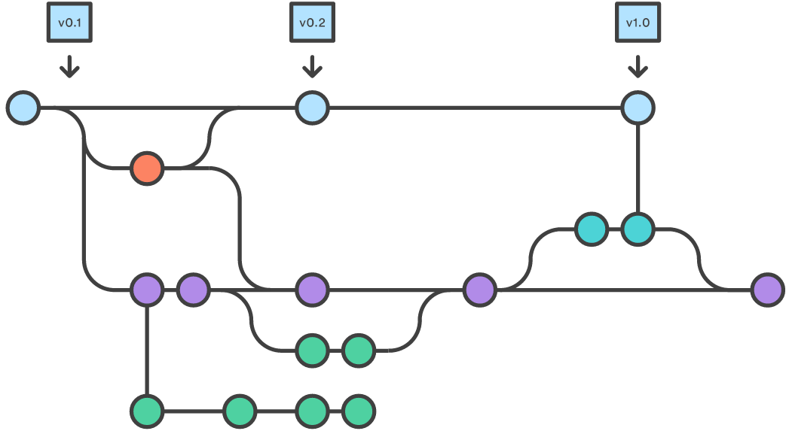





How we work together (Branch)
Notes:
flexible

Slide 10

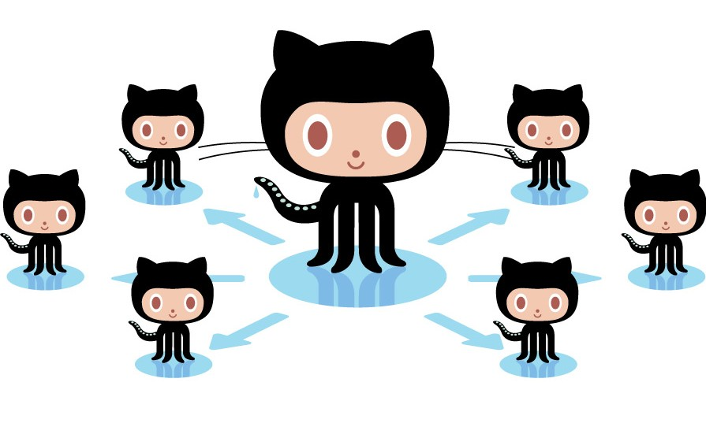
GitHub – share codes with others
International global work: business, production, development
Share
Search
Code review
Workflow synchronies
Automation experimentation
Collaboration culture
Repo PNB

Slide 11
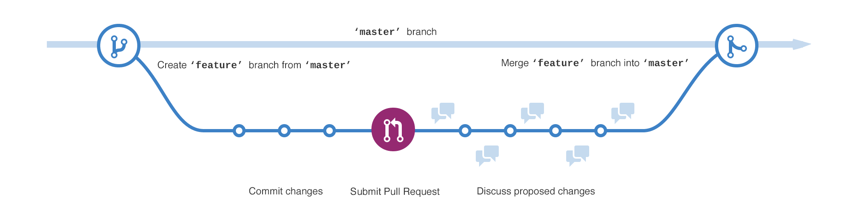
Pull request – best tool
Coaching & social coding
- there is always someone you can learn from.
Code review
Automation unit test
Independences check
Compile check
https://guides.github.com/introduction/flow/
Notes:
Pull requests are a simple and effective way to do code review and collaboration in a shared environment with little friction for your team.
Pull requests give you:
Complete diff (difference) of the changes to each file.
Automatic updates so you can see changes as they are made.
Inline comments so you can pinpoint change suggestions.
Tasks to help you keep track of what changes need attention.
Notifications for comments, commits, or approvals.

Slide 12
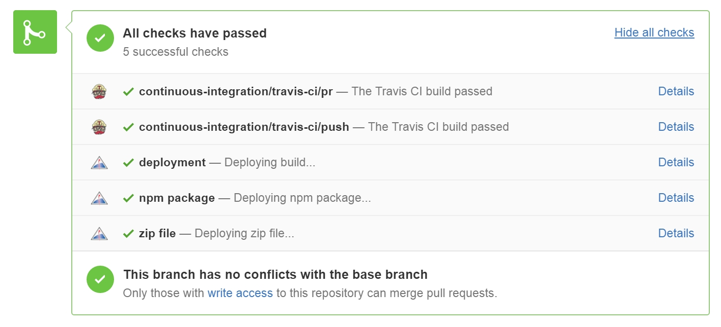
Cool things
Documents: Wiki, Readme, Webpage (Jekyll Themes)
Powerful diff: Claire compare, Images.
Code check:
Sample : https://github.com/twbs/bootstrap

Slide 13

Flexible, powerful and rapid,offline.
Organisation /team support (Read, write) with LDAP, prevent force push and restricted branch. (github 2.7)
Mail and comments issue.
Plugin IntelliJ and Eclipse.
Work with JIRA workflow.
Work with Bamboo, automated builds, tests and releases.
Big file (100M), 2G using Large File Storage (LFS) Git
Complex, but don't be afraid.
Don't have an awesome Client(GitHub desktop, TortoiseGit (git 1.9))
Not yet support GSD in France.

Slide 14

Links
Installation:
GSR: https://community.global.hsbc/sites/engpractices/Development%20Cookbook/GitHub.aspx
Jira integration: https://community.global.hsbc/sites/engpractices/Development%20Cookbook/Using%20JIRA.aspx
Github confluence: https://alm-confluence.systems.uk.hsbc/confluence/display/DSALM/GitHub
Tips:
Git Workflow: https://www.atlassian.com/git/tutorials/comparing-workflows/gitflow-workflow
Git try: https://try.github.io/levels/1/challenges/1
GitHub tutorial: https://help.github.com/enterprise/2.7/user/articles/good-resources-for-learning-git-and-github/
GitHub resource: https://help.github.com/articles/good-resources-for-learning-git-and-github/
Example: https://github.com/twbs/bootstrap
PNB GROUP
Notes:
GSR: un github account + Installing Git Client -

